Slide 1
Capstone Project - 1
EDA on Play Store App Reviews
By
SANDEEP KUMAR SINGH
Data Science Trainer, AlmaBetter

Slide 2

Problem Statement
Two datasets are provided, one with basic information and the other with user reviews for the respective app.
We must examine and evaluate the data in both datasets in order to identify the important characteristics that inﬂuence app engagement and success.
So, what factors inﬂuence an app's success?
An app is said to be successful if it has:
A high average user rating
A good number of positive reviews
A good number of monthly average users
High revenue per customer and so on.

Slide 3


Data Summary
Play_Store_Data
User_reviews
App
Translated Review
Sentiment
Sentiment_Polarity
Sentiment_Subjectivity
App
Category
Size
Rating
Reviews
Installs
Type
Price
Content Rating
Genres
Last Updated
Current Ver
Android Ver
Rating Group
Revenue

Slide 4

Agenda
Correlation heatmap
Type and Content Rating Analysis
Categorical Analysis
App Rating Analysis
Top Free and Paid Apps
Average Price of Paid Apps in Each Category
Most Popular Apps
App Size Analysis
App Reviews Analysis
Challenges Faced
Analysis Summary

Slide 5
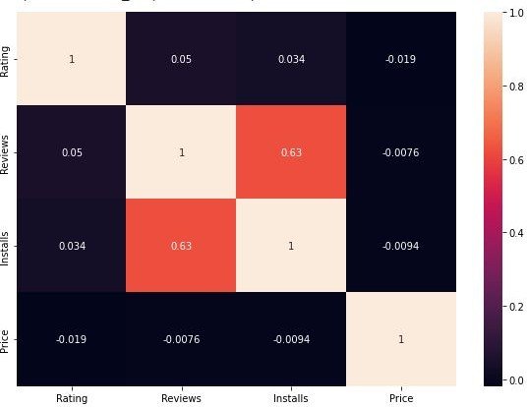
Correlation Heatmap
❏ There is a strong positive correlation between the Reviews and Installs.
❏ The Price is slightly
negatively correlated with
and
the Rating, Reviews, Installs.
❏ The Rating is slightly positively correlated with the Installs and Reviews.

Slide 6
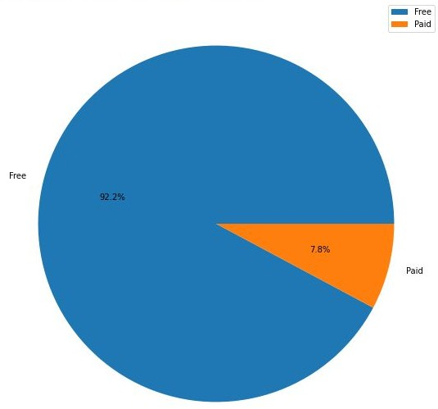
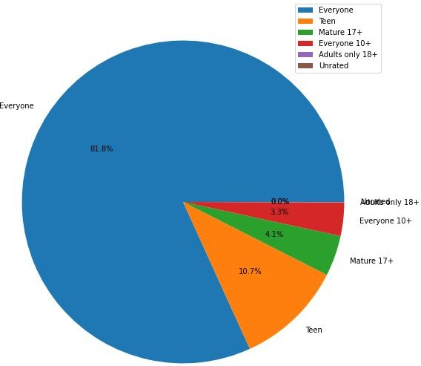
Type and Content Rating
Free and paid apps in the df
Content rating types in the df

Slide 7
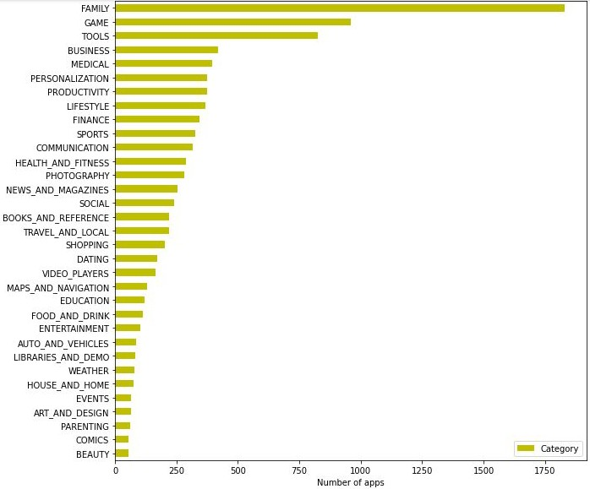
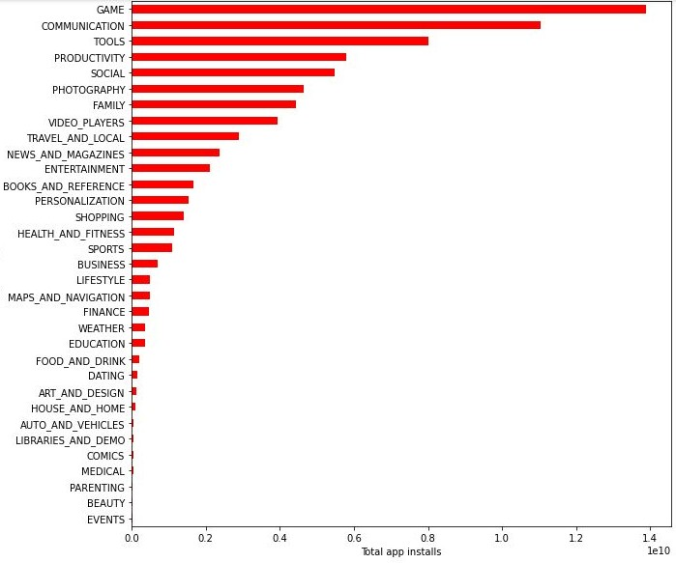
Categorical Analysis
Category vs No. of Apps
Category vs Total App Installs

Slide 8
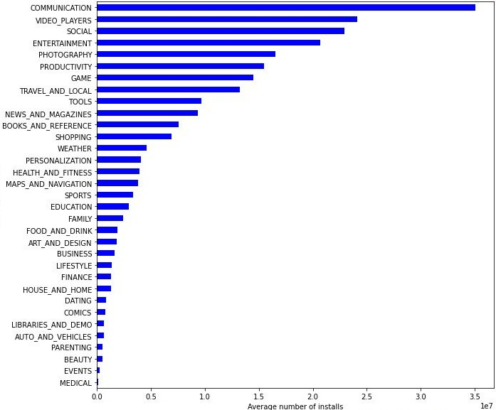
Categorical Analysis (Contd.)
The Family, Game, and Tools category has the highest number of apps.
The Game, Communication, and Tools category has the highest number of app installs.
The Communication, Video Players, and Social category has the highest number of average app installs
Average App Installs in Each Category

Slide 9
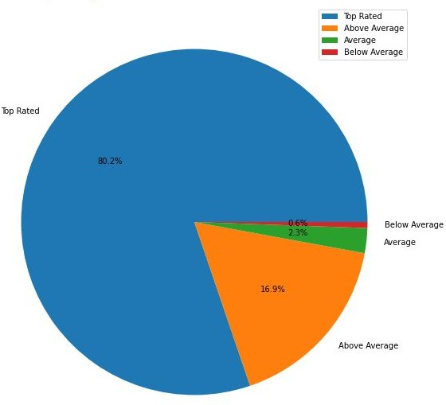
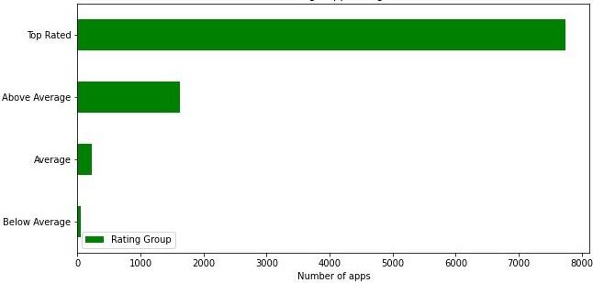
App Rating Analysis
The average user rating is divided into 4 categories:
Rating: 4-5 ⇒ Top Rated
Rating: 3-4 ⇒ Above Average
Rating: 2-3 ⇒ Average
Rating: 1-2 ⇒ Below Average
The majority of the apps in the Play Store (~80%) are top rated.
This implies that the majority of the users are happy with the services received via the respective app.

Slide 10
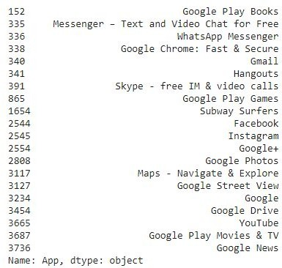

Top Free Apps
There are a total of 20 free apps with over one billion installs.
The top categories in which these apps fall are Communication(6), Social(3), Video Players(2), Travel and Local(2).

Slide 11
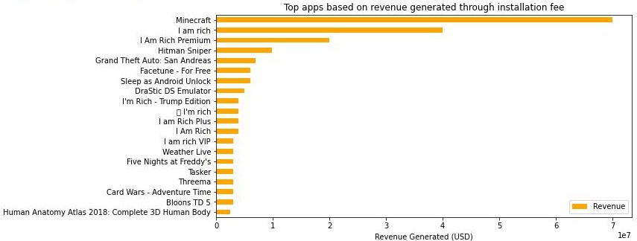
Top Paid Apps Based on Revenue Generated
Revenue generated is given by the formula:
Revenue = Installs * Price
Note that in this case, revenue refers to the money earned only from paid app installs.
The top categories in which these apps fall are Lifestyle(5), Family(5), and Game(4).
Minecraft, I am rich, and I am rich premium are the top paid apps based on revenue generated.
Minecraft is the only app that has over 10M installs.

Slide 12
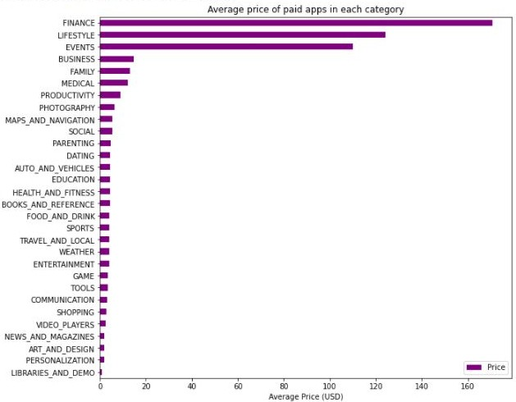
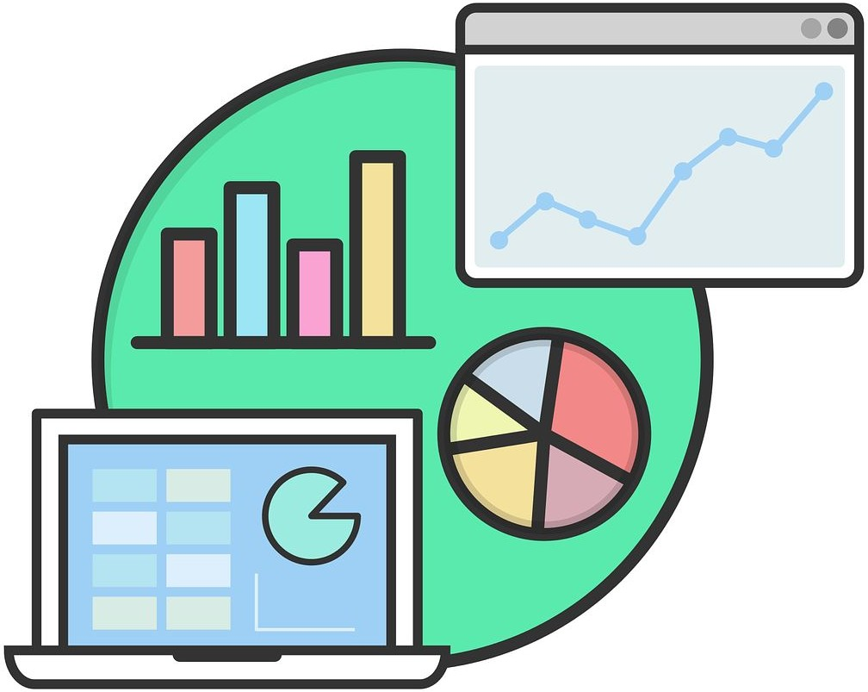
Average Price of Paid Apps in Each Category
❏ The paid apps in the Finance, Lifestyle, and Events category are on average signiﬁcantly more expensive than the paid apps in other categories.

Slide 13
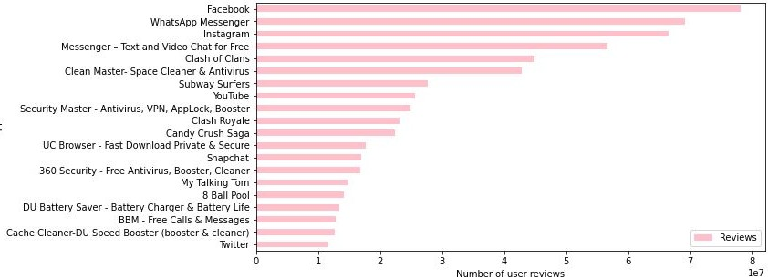
Most Popular Apps
We can state that the apps with more reviews, whether positive, negative, or neutral, are more popular than the others.
This is because the number of user reviews indicates that these individuals have engaged with the app's content and have written their opinions on it.

Slide 14
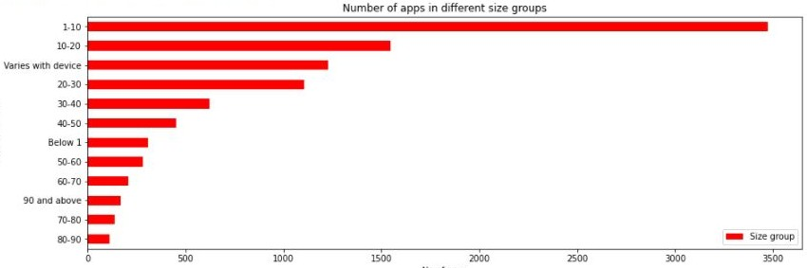
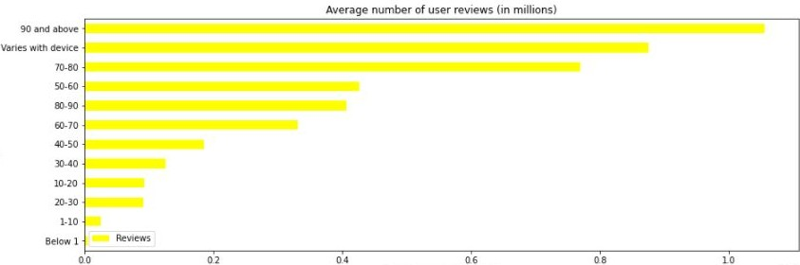
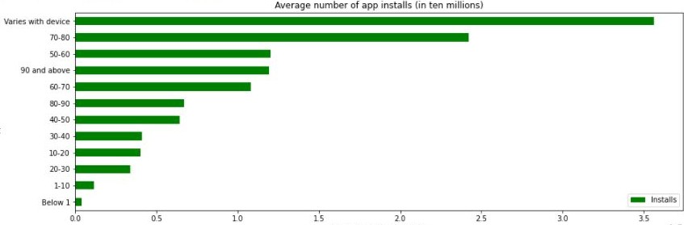
App Size Analysis
The apps are categorized based on its size between
~0 to 100 MB in the intervals of 10 MB each.
The total number of apps in each size category indicates the competition.
Average number of user reviews and average app
installs in each size
the the
category indicates
popularity of
respective app.

Slide 15
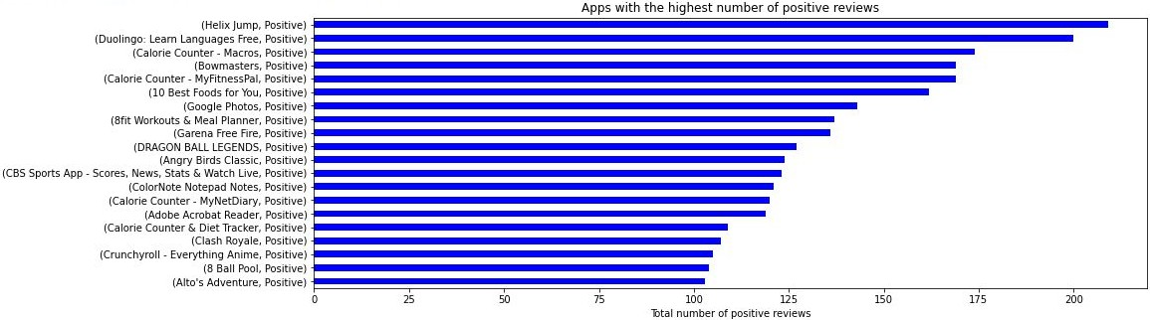
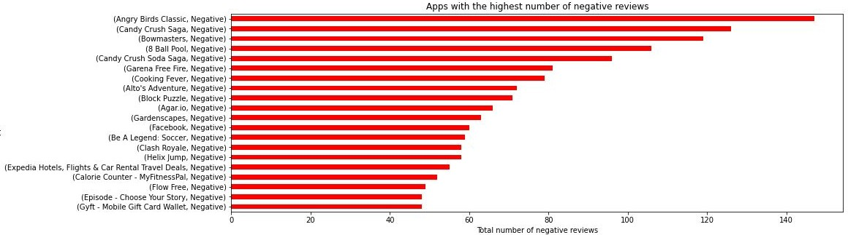
Positive and Negative Reviews

Slide 16
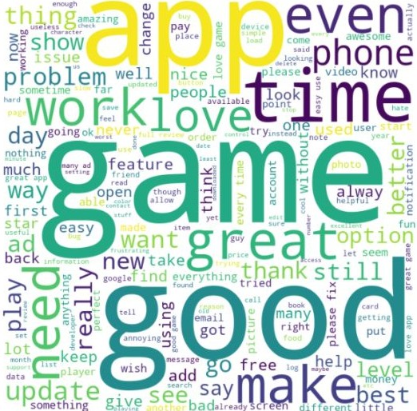
Word Cloud on translated reviews
The word clouds is used as a visual representation of any textual data, in this case the user reviews.
The higher the number of times a word is repeated, the bigger and bolder it gets.
Hence the word clouds can be used to get a birds eye view of all the textual data in the dataset.

Slide 17

Challenges Faced
Reading the dataset and comprehending the problem statement.
Examining the business KPIs for app development and devising a solution to the problem.
Handling the error, duplicate and NaN values in the dataset.
Designing multiple visualizations to summarize the information in the dataset and successfully communicate the results and trends to the reader.

Slide 18
Analysis Summary
Percentage of free apps = ~92%
Percentage of apps with no age restrictions = ~82%
Most competitive category: Family
Category with the highest number of installs: Game
Category with the highest average app installs: Communicaction
Percentage of apps that are top rated = ~80%
There are 20 free apps that have been installed over a billion times
Minecraft is the only app in the paid category with over 10M installs, and also has produced the most revenue only from installation fee.
There is a positive correlation between the reviews and installs. And also between rating with installs and reviews.
Price is negatively correlated with the rating, reviews, and installs.

Slide 19
Analysis Summary (Contd.)
❏ Category in which the paid apps
have the highest average
installation fee: Finance
Most popular app in the Play Store based on the number of reviews:
Facebook
The median size of the apps in the play store is 12 MB
The apps whose size varies with device has the highest number average app installs.
The apps whose size is greater than 90 MB has the highest number of average user reviews, ie, they are more popular than the rest.
Helix Jump has the highest number of positive reviews and Angry Birds Classic has the highest number of negative reviews.

Slide 20

Thank You

